Slide 1

Dream Magic Studios & Polishing The Professional: Production
Bridging Opportunities for Inclusion

Slide 2
Agenda
Podcast Overview
Our Mission
Benefits of Joining
Collaborating with Regional Centers
Meet the Team
How to Get Involved
Q&A

Slide 3
Production overview
The production is a collaboration between Polishing The Professional and Dream Magic Studios. The podcast is for people with disabilities by people with disabilities.
The production is currently a podcast with episodes that will be a 30-minute weekly show. The topics discussed in the podcast will focus on the issues and interests of those living with a disability. The podcast will give an authentic voice to those living with a disability.
Accompanied by guest speakers that are also a part of the disabled community, our podcast is aimed to educate and motivate viewers alike.
Our podcast crew are all unique individuals with different disabilities who share an interest in the entertainment industry.
Qualified individuals are those who already possess a skill, experience, or background/education in the entertainment world.

Slide 4
OUR MISSION
Our mission is to prepare individuals with disabilities for success in their chosen career path. We do so by helping them gain hand-on experience in the entertainment industry working alongside experienced coaches. Our goal is to show the world that despite facing physical or mental disabilities, you can still pursue your dream career.
Polishing The Professional (PTP) is a full-service career center. Offering person-centered planning, we help job seekers identify careers that complement their strengths, skills, and interests. PTP serves individuals in different phases of their careers such as: graduates entering the workforce, displaced professionals re-entering the workforce, adult workers seeking advancement, seniors, and veterans transitioning careers, or executives seeking leadership training.

Slide 5
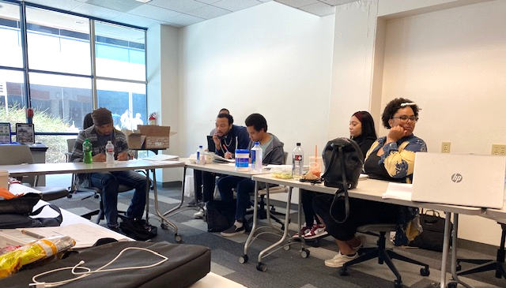
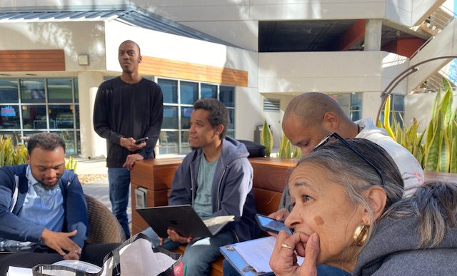
BENEFITS OF JOINING
Most of our interns have shared experiences of not being taken seriously when searching for permanent jobs especially in the entertainment industry. We take the time to guide our clients through the process of stepping into their position.
Once clients join our production, they are paired with an experienced coach to help guide them to fulfill their role.
Our coaches help prepare our interns with the experience and skills needed to confidently pursue their dream career in the entertainment world in addition to building a strong support network.
Clients work up to 20 paid hours a week with their coach one on one. We offer schedule flexibility around school or other duties.
Ultimately the goal is to foster inclusivity and empowerment between our clients and the entertainment industry.

Slide 6
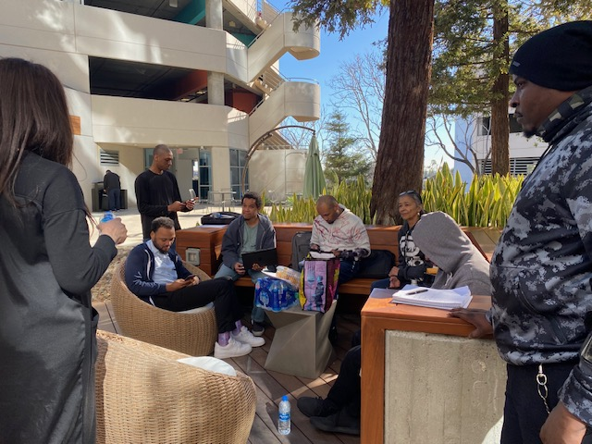
REGIONAL CENTERS
Polishing The Professional has vendorization with several regional centers across Los Angeles County.
All our clients are provided coaching as part of our services.
We are open to new client referrals for both the production positions or other employment assistance for individuals not eligible to participate in the podcast.

Slide 7
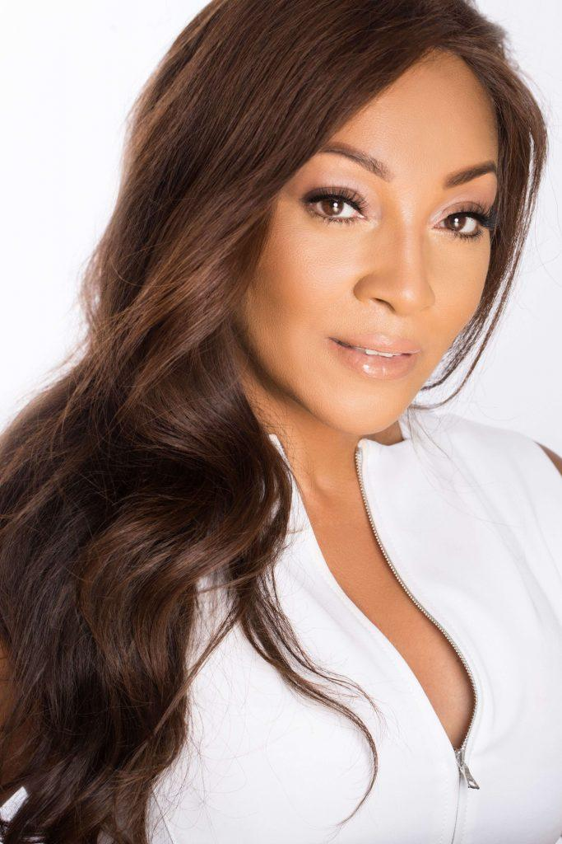
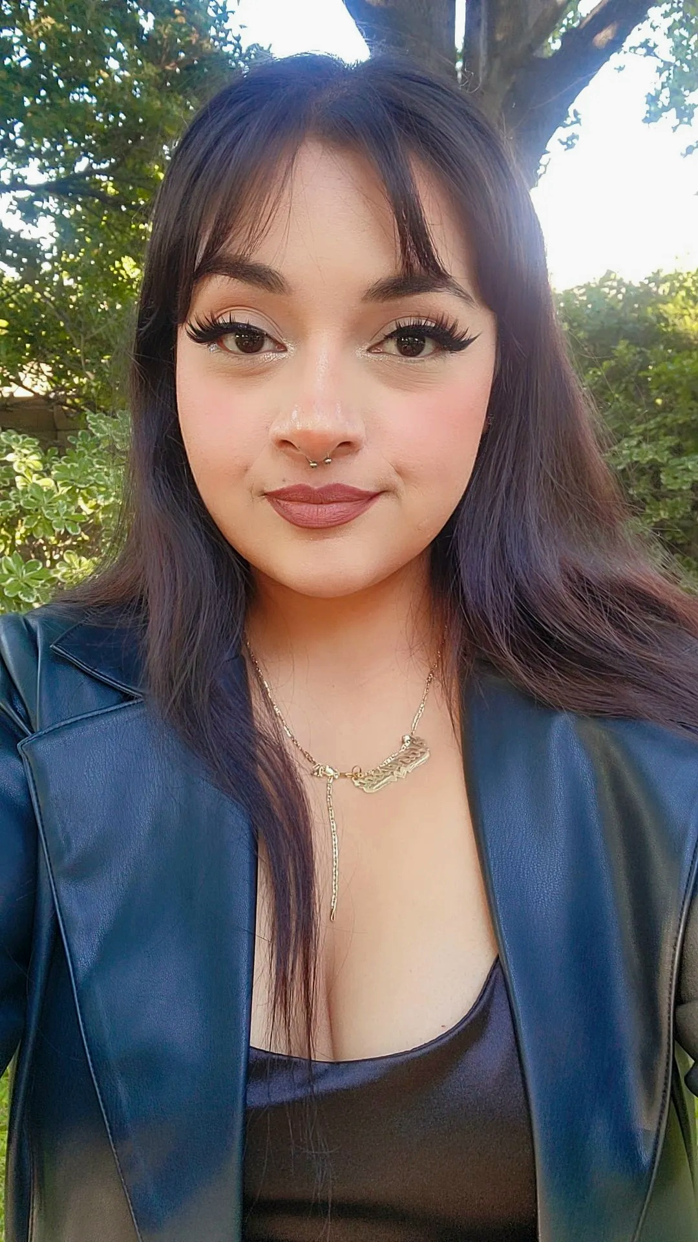
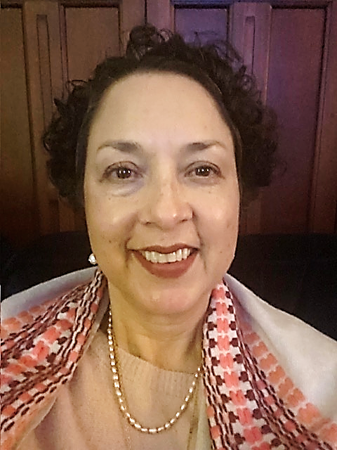
Meet The Team
Bertha Rodriguez
Production Manager
Davina Douthard
CEO of Polishing The Professional
Vanessa Martin Del Campo
Program Assistant

Slide 8
HOW TO GET INVOLVED
Eligibility criteria
Must have a disability and an interest in television and film production.
Have relevant experience or education in the desired role.
Required to complete professional development, production training, and paid internship.
Commit to all production days required for shooting, depending on the position.
Must have reliable transportation to the production days (assistance may be available).
Must demonstrate past excellent attendance in prior programs.
Required to live in Southern California.
Application process - Client is required to be part of a Regional Center. The Service Coordinator must send a referral packet to the Program Assistant (IPP, CDER, psychological report, psychosocial report & medical report). Once the referral packet is received, an interview will be scheduled to meet with the candidate and the Production Coordinator. If the candidate meets eligibility, a POS for training and assessment will be requested to the Service Coordinator. A PIP request will be sent to the Employment Specialist.

Slide 9
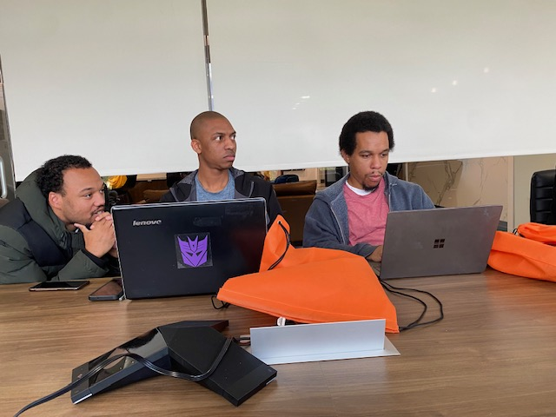
Testimonials
Success stories from current crew members:
Antonio Faten – One of our current script writers found successful employment with an entertainment studio after being a member of our podcast and improving his skills with his coach.
Ebonee Green – Our current catering host has been able to learn more about running a catering business by being a part of podcast crew as a Catering Chef. She currently runs her own business Sincere Delights and is working on expanding her business.
Amyanna Webster – Our current makeup and hair stylist has previous experience as a nail tech and is expanding her skills with hair and makeup on set. She will soon be able to apply these skills successfully in her career path in the beauty industry.

Slide 10
Q&A
We are open to questions!

Slide 11
thank YOU!
Contact us:
Polishing the Professional: (310) 540-5120
Production Manager:
Bertha Rodriguez
Bertha.r@polisheddcc.com
(310) 540-5120 ext. 142
Program Assistant:
Vanessa Martin Del Campo
Vanessa.d@polishedcc.com
(310) 540-5120 ext. 148

